Slide 1

We value the quality of our work,
the quality of our experience,
and the quality of our relationships.

Slide 2

Design & Engineering
- Offer Design
- Sustainability Check
- Open Costing
- Product Engineering to make competitive price
- Alternative Materials source
Manufacturer Allocation
- Price Confirmation
- Production Space Booking
Sample Submission
- Proto Sample
- Sample Evaluation
- PP Meeting
Merchandising
- Day to day follow up
- Materials Quality and Color confirmation
- Testing follow up
- TNA
- Bulk Materials Check
- Production Follow UP
Quality Check
- Sales Contract
- Technical Audit
- Social Audit
- Inline
- Mid Line
- Pre Final
- Final AQL
- Fit Check
- Workmanship reengineering
- PP sample Check
- Ship Sample check
Logistics Support
- Vessel Booking
- Invoice, Packing list etc
- Shipping update

Slide 3
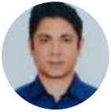
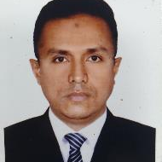

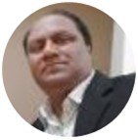
Shakirul Haque
CEO
Amir
Business Head
▪ Sourcing Experience in Retail and Manufacturing .
▪ Excellent Product & Technical Knowledge.
▪ Super understanding of Brands DEMANDS.!
▪ Emotionally intelligence and extra ordinary on relation maintain capabilities with Manufacturers.
▪ Highly Motivated and willing to run the extra mile.
▪ Professional Business leader with very high Performance record
Shakil - CEO
Ex Office Manager Coles Group, Motivational Leader
Email: shakil@sourcedirect-info.com
Mobile: +8801713257876
Ex Office Manager Myer Australia
Email: amir@sourcedirect-info.com
Mobile : +8801729090678
Kalam Azad
Business Head
Ex Office Manager Target Australia
Skilled in Trend Analysis, Negotiation,
Global Sourcing for Retailers.
Email: azad@sourcedirect-info.com
Mobile: +8801760 423 020

Slide 4














…….. Sustainability
Producing a positive impact has always been at the heart of Source Direct. Our conscious approach started from beginning when we set our social and ethical compliance strategy. Our vision always has and will always be People, Passion and Partnership.
Source Direct is committed to working with leading industry eco-communities to develop our preferred fiber portfolio and to improving industry practices to continually bring positive environmental and societal changes for our communities.
Our passion for innovation is what continually drives and motivates us. Source Direct takes pride in innovating sustainable low impact materials to reduce the environmental impact of its products. Our innovation team is constantly working with subject experts and industry consultants to develop the newest ‘fit for purpose’ sustainable proposals.
Our Accreditation ………..

Slide 5

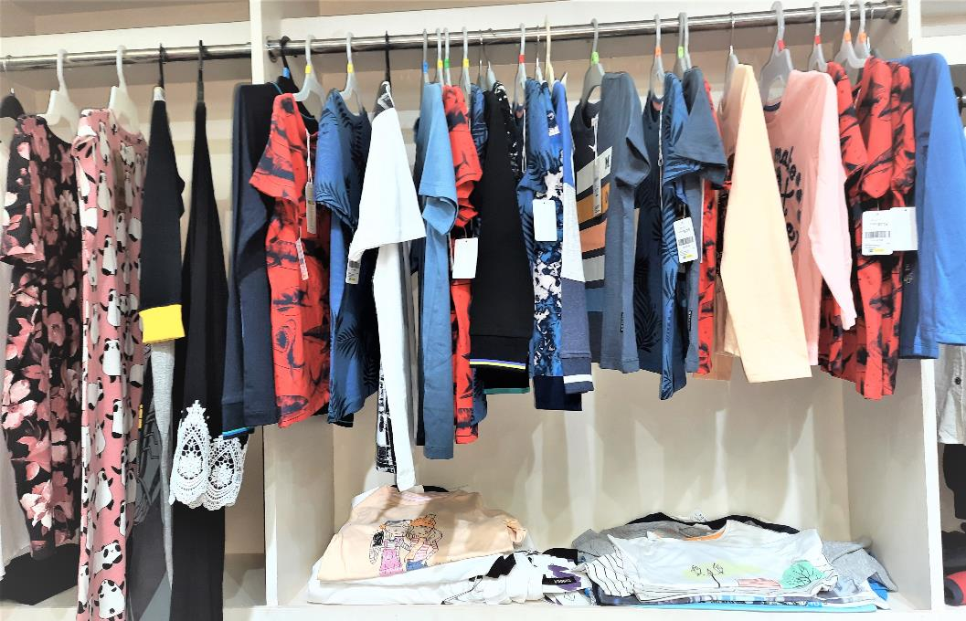
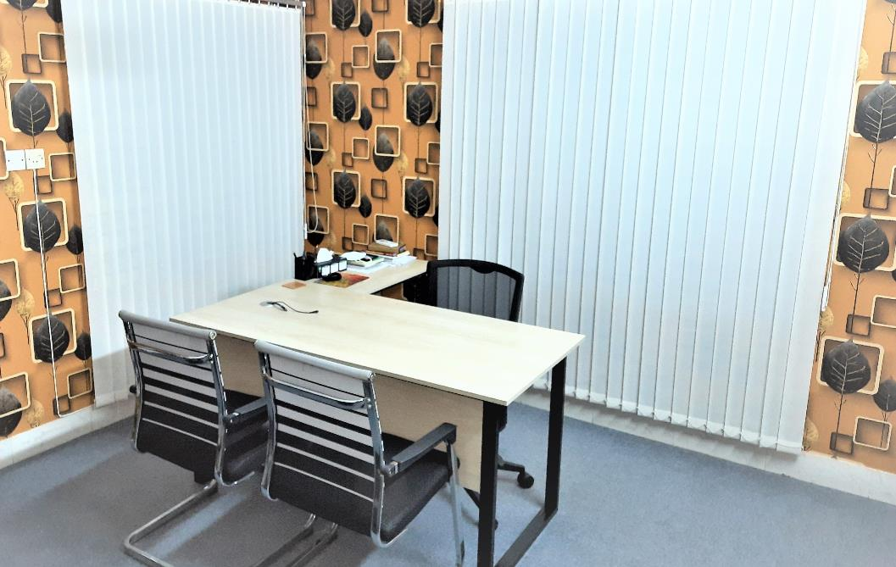
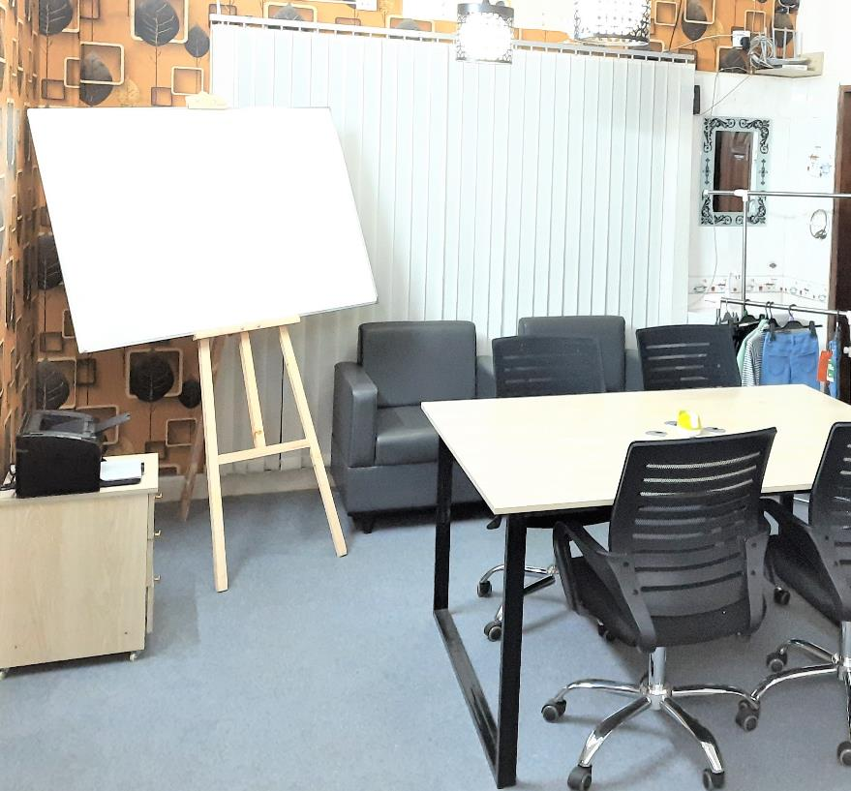
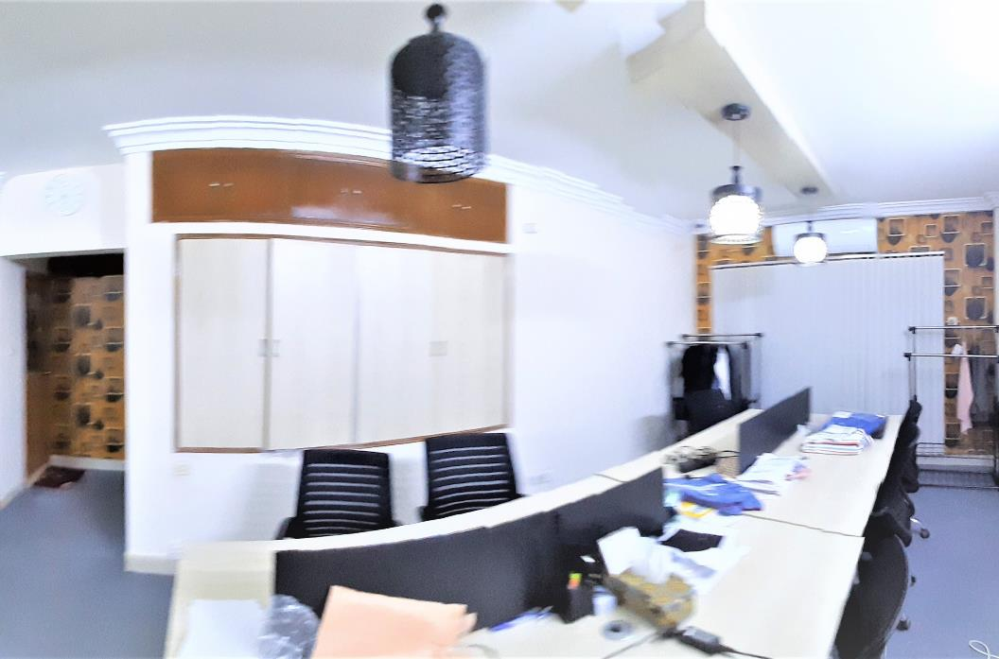
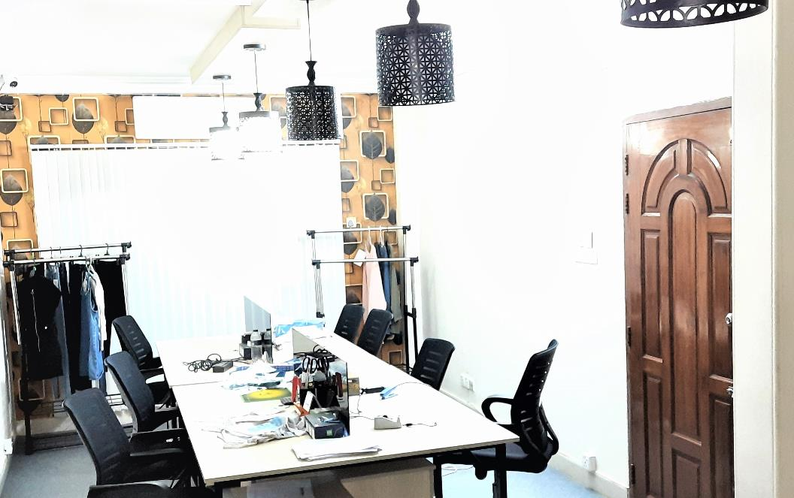
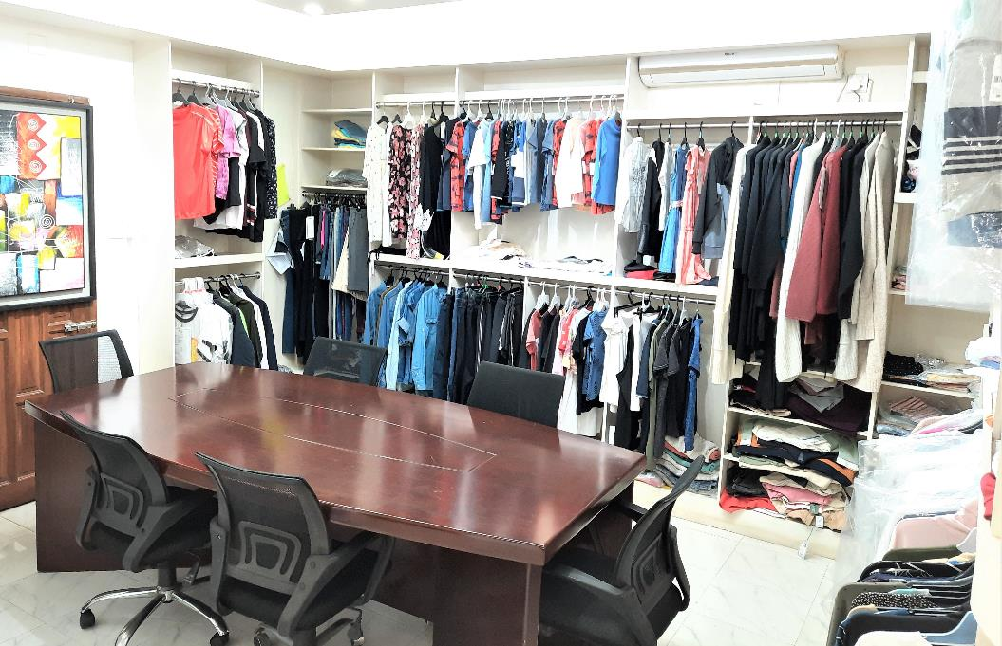
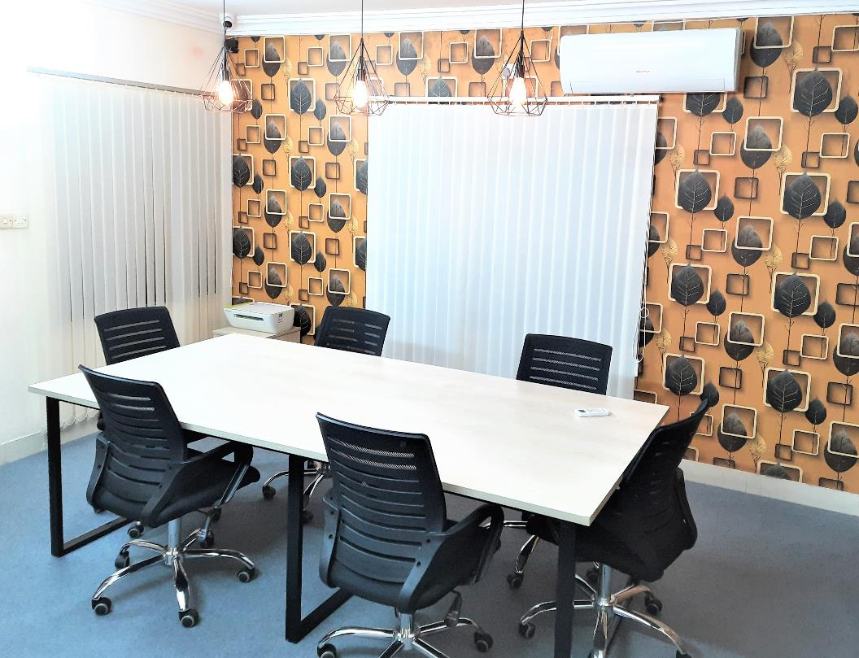
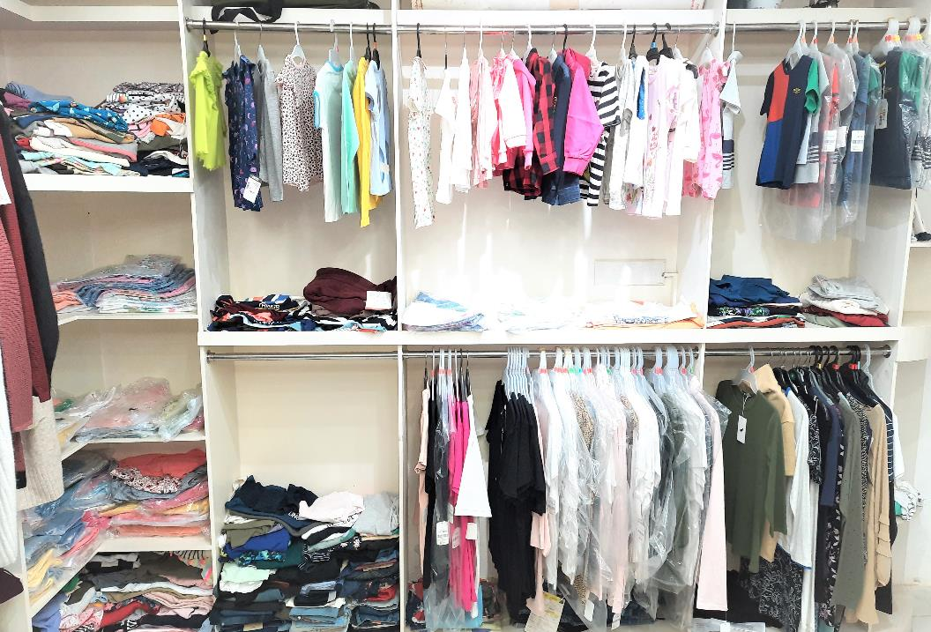
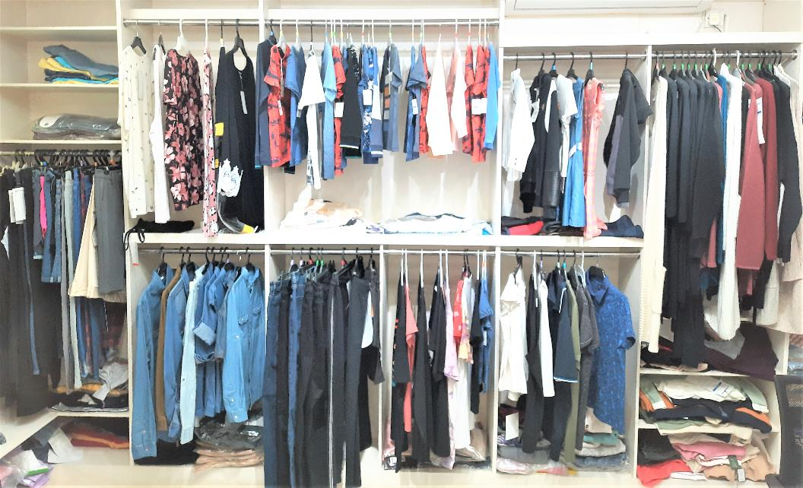
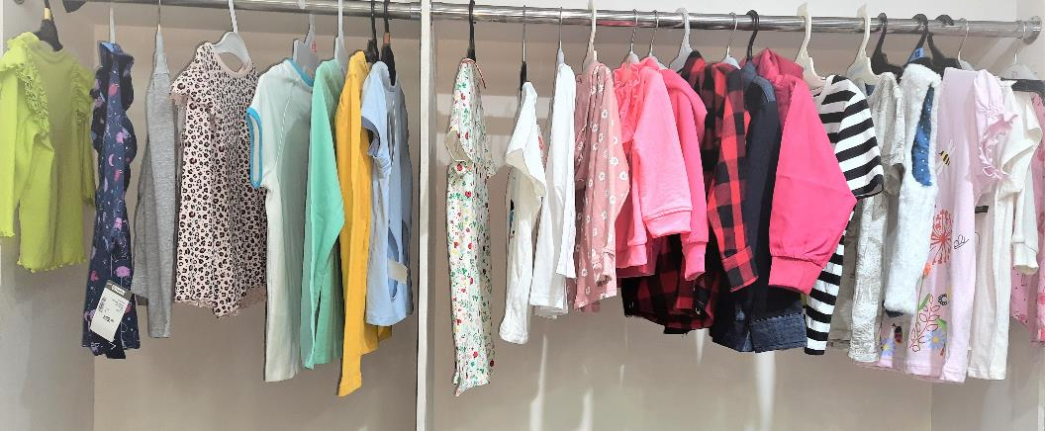
Sample Display
Business Head
Quality Dept
Merchandising
Merchandising
Meeting Room-1
Meeting Room - 2
Sample Display
Sample Display
Sample Display

Slide 6
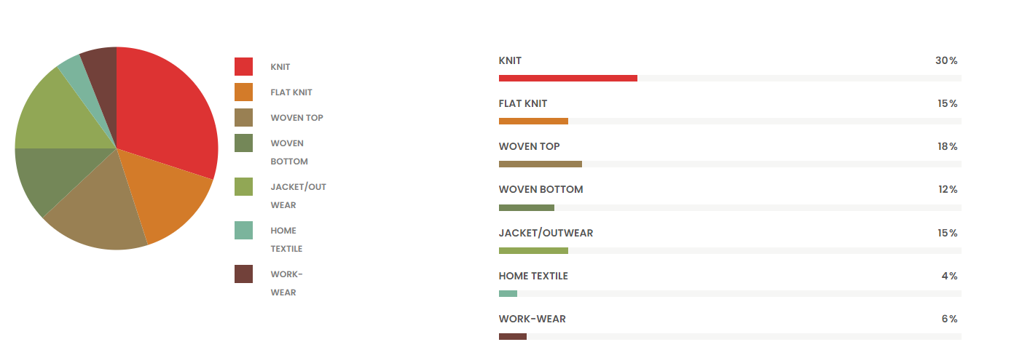
PRODUCTS
1
2
3
4
WOVEN
KNIT
SWEATER
HOME TEXTILE
HOME DECOR
Jacket
Woven Tops
Shirt
Denim
Woven Bottoms
T-shirt
Polo shirt
Tank Top
Jogging suits
Trouser
Night wear
Underwear
1.5 & 3 gauge
5 gauge
7 gauge
12 gauge
BED SHEET
QUILT COVER
CUSHION COVER

Slide 7














Thank You.!

